Slide 1
Cardiovascular disease predictive models
By: Yuyang Sun, Xinyu Shen, Xinye Li

Slide 2
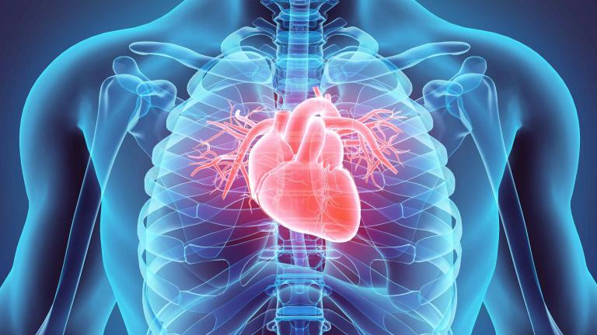
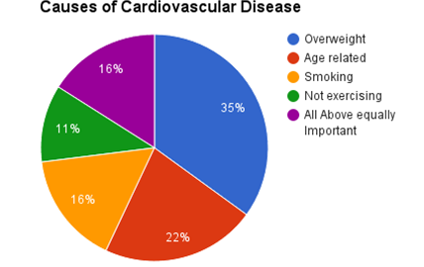
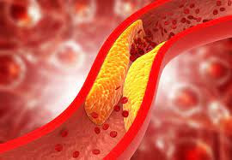
Background:

Slide 3

Broad Picture
Data selecting (KAGGLE) / checking
Correlation(Heatmap) visualization
Select variables
Machine learning
Logistic Regression
Decision Tree
Random Forest
Support vector machine
Accuracy Tuning
Patient selection / Utilizing the models

Slide 4
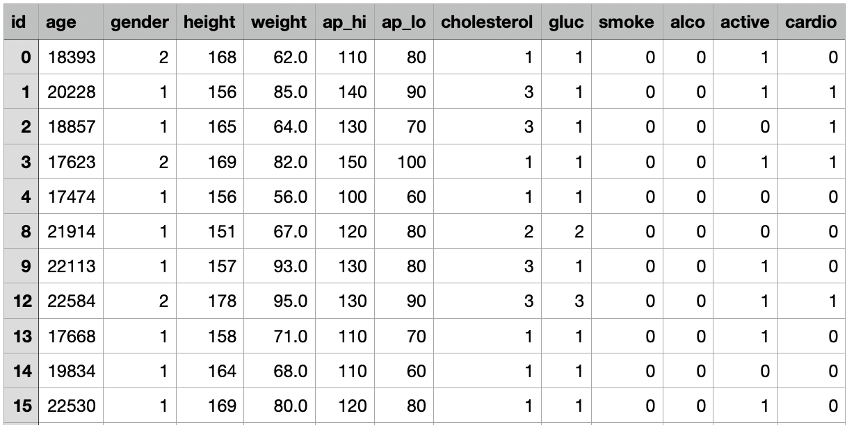
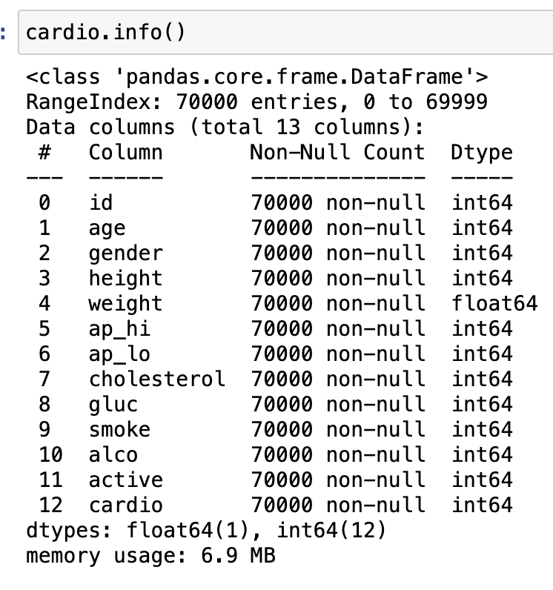
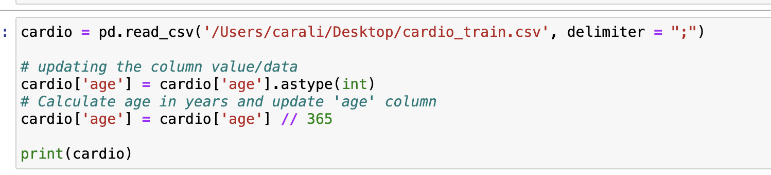
Data selecting & checking
CHECKING for missing values
ORIGINAL DATA-kaggle
UPDATE the age from dates to years

Slide 5
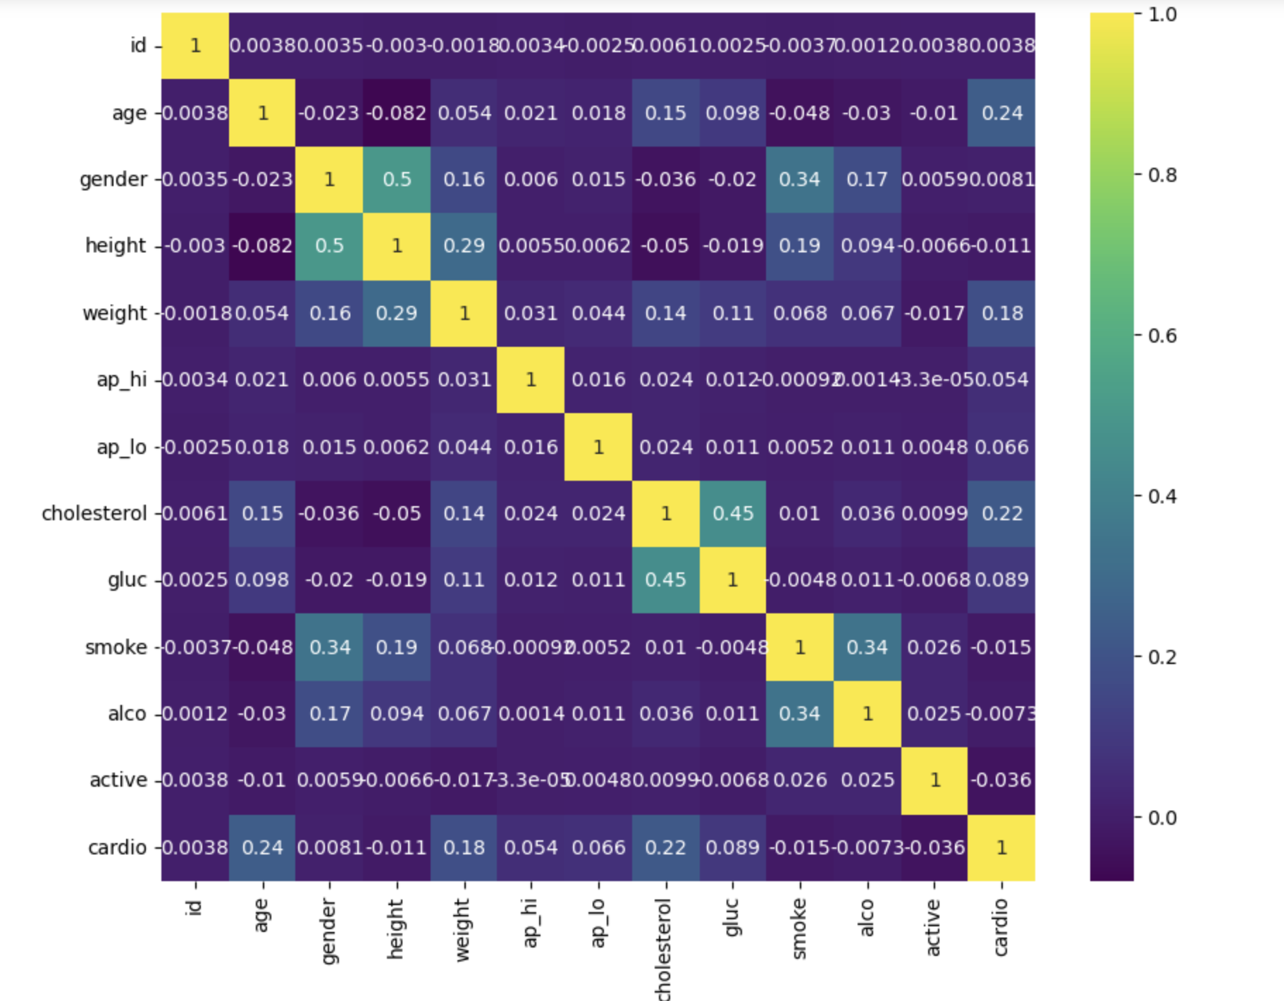
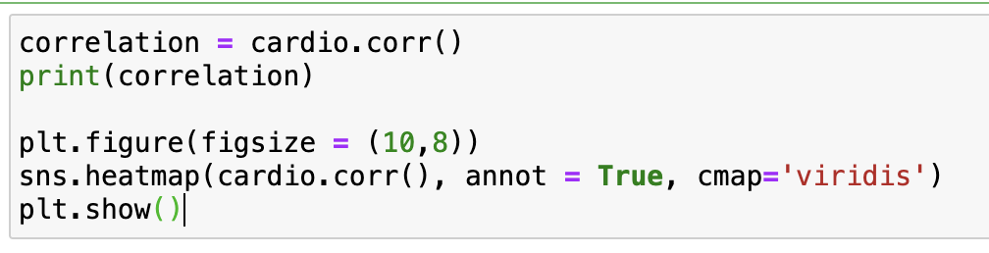
Correlation
Color for each cell = strength and direction of the correlation.

Slide 6
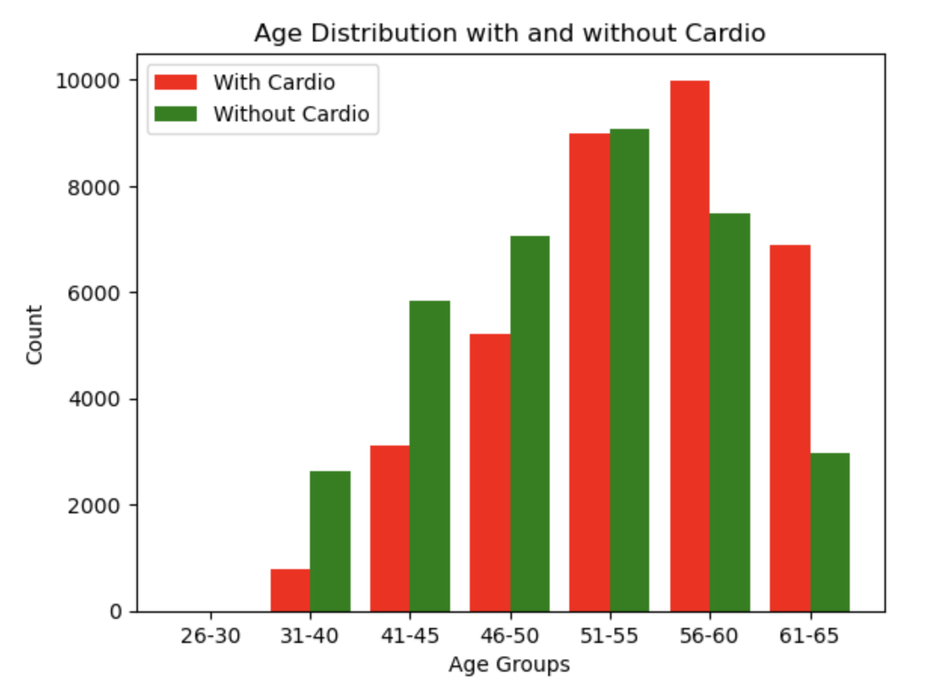
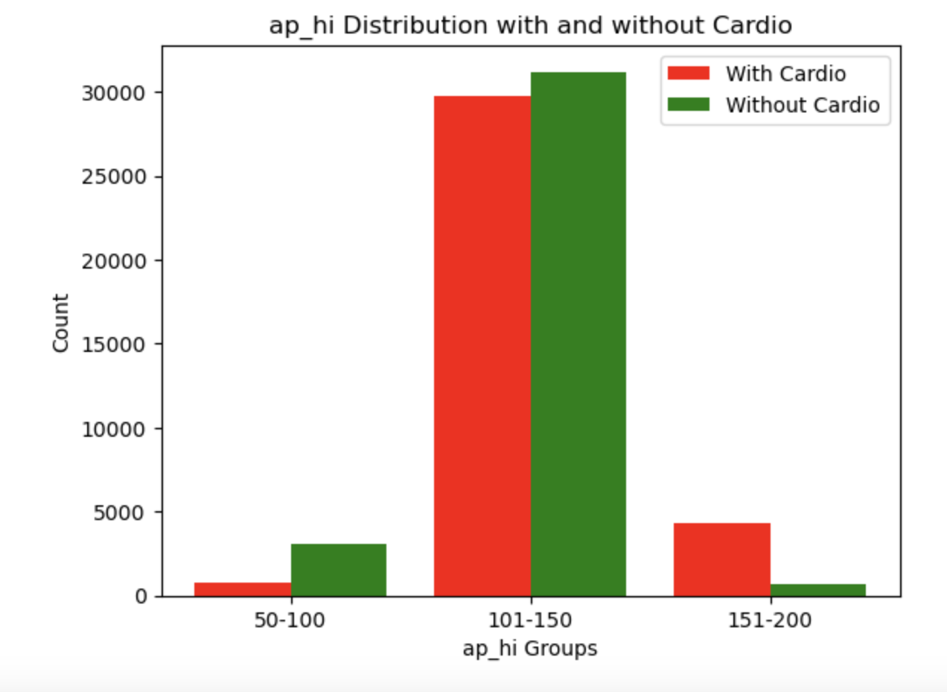
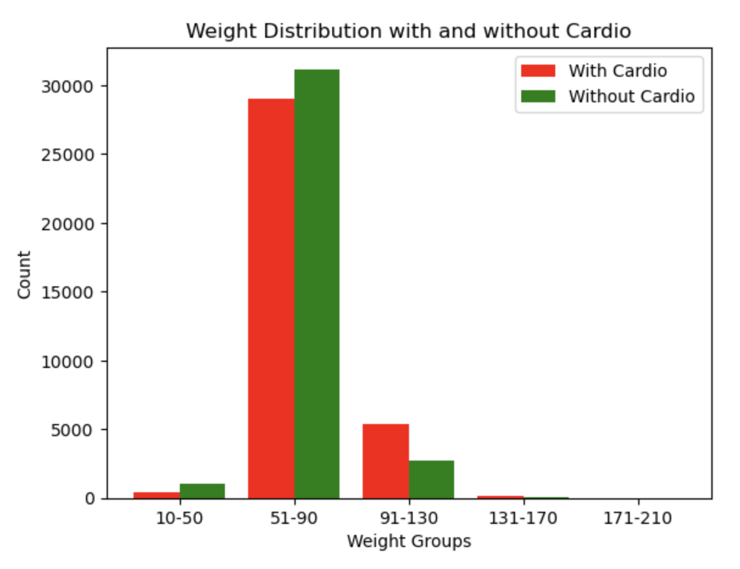
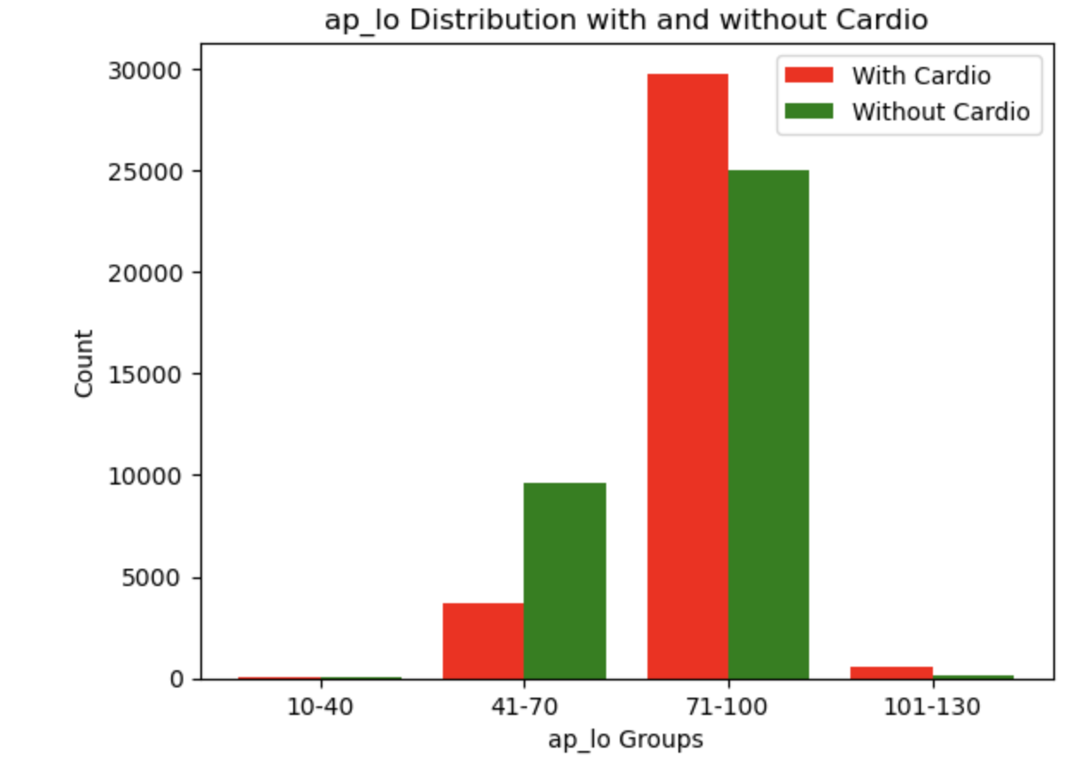
Comparison graphs
Notes:
After the heatmap is generated, we decided to use 6 variances that show the most correlation with the disease which are: age, weight, ap_high, ap_low, cholesterol, and glucose

Slide 7
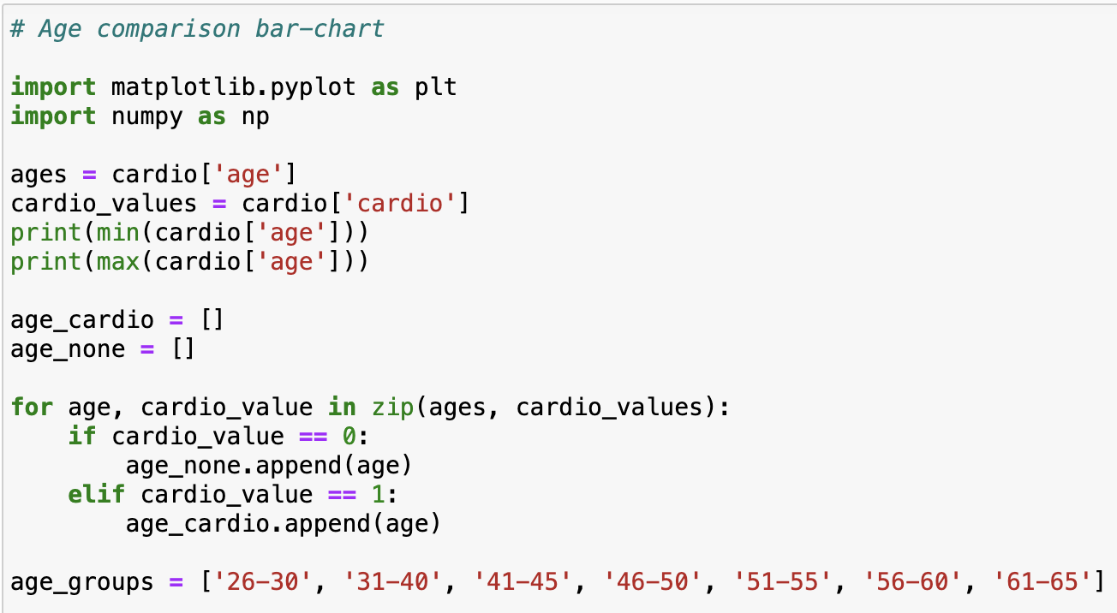
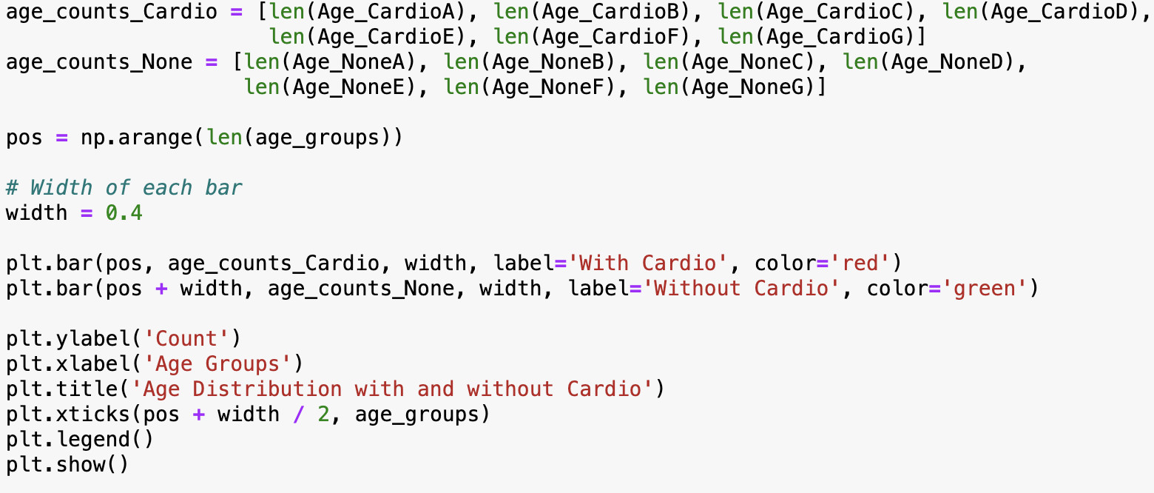
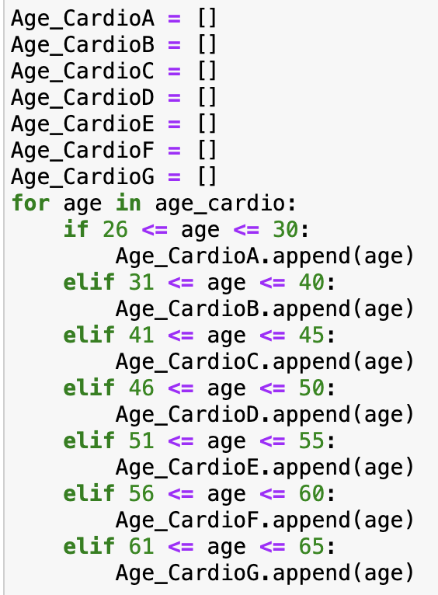
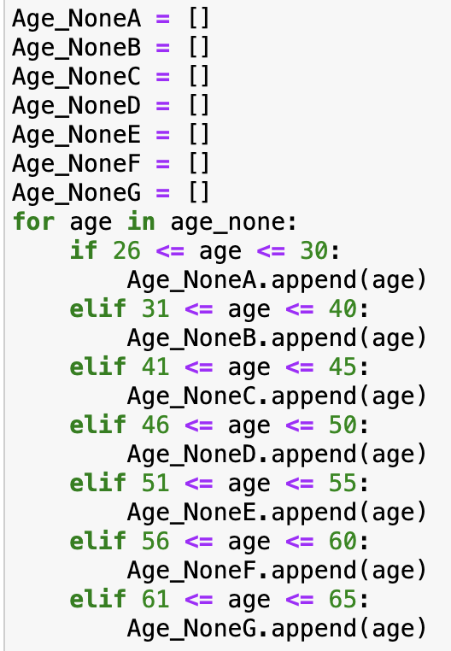
How we made the comparison graphs

Slide 8
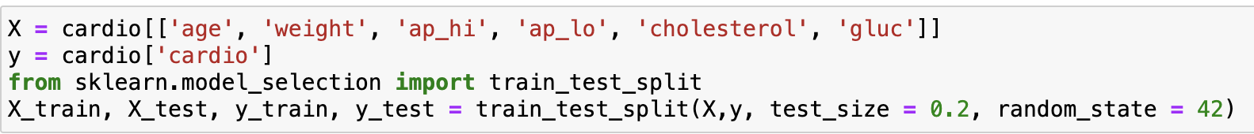
Training the models ( 80%training, 20%testing)
 | VAR1 | VAR2 | VAR3 | VAR4 | VAR5 | VAR6 | VAR7 | VAR8 | VAR9 | VAR10 | VAR11 | ✅/❌
1
2
3
4
5
6
7
8
9
10
x_train
y_train
x_test
y_test
Notes:
To apply machine learning, we decided to use 80% of the data for training and 20% of the data for testing.
To demonstrate, In this example here, there’re 11 variables and 10 rows.
The light green symbolizes the data I would use for x_train, the dark green is y_train,
Light orange is x_test, and dark orange is y_test.
According to the code here, we can see that it took the 6 variables we chose and the corresponding result.
And it splits the data as 0.2 is the test_size and 0.8 is the train_size.

Slide 9
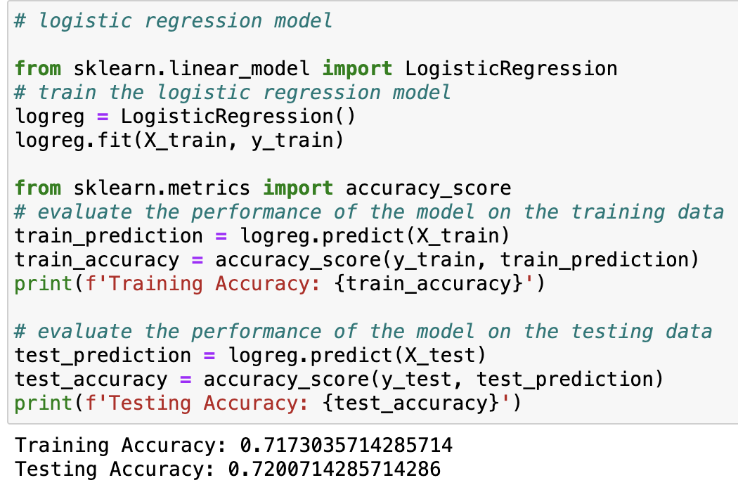
Logistic Regression
It’s a basic statistical model using a logistic function to estimate the probability of a binary outcome based on the input factors.
It models the outcome of the probability of 0 and 1- either getting the cardiovascular disease or not.

Slide 10
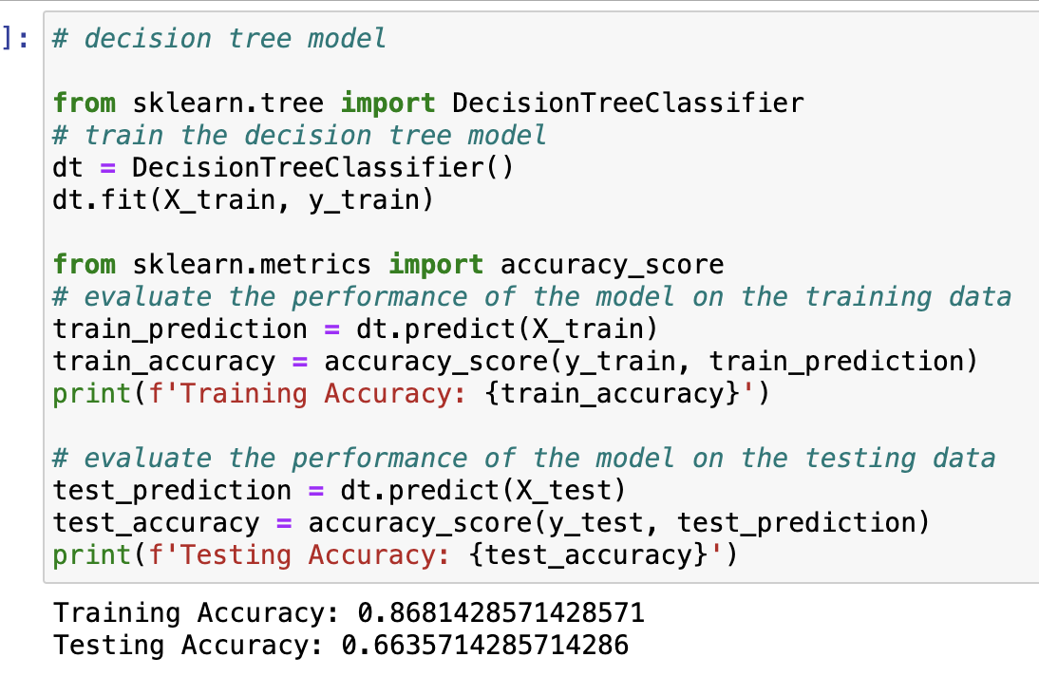
Decision Tree (DT)
Decision Trees is widely used in machine learning for classification and regression.
By using DT, we could predict the value of a target variable by learning simple decision rules from the data features.

Slide 11
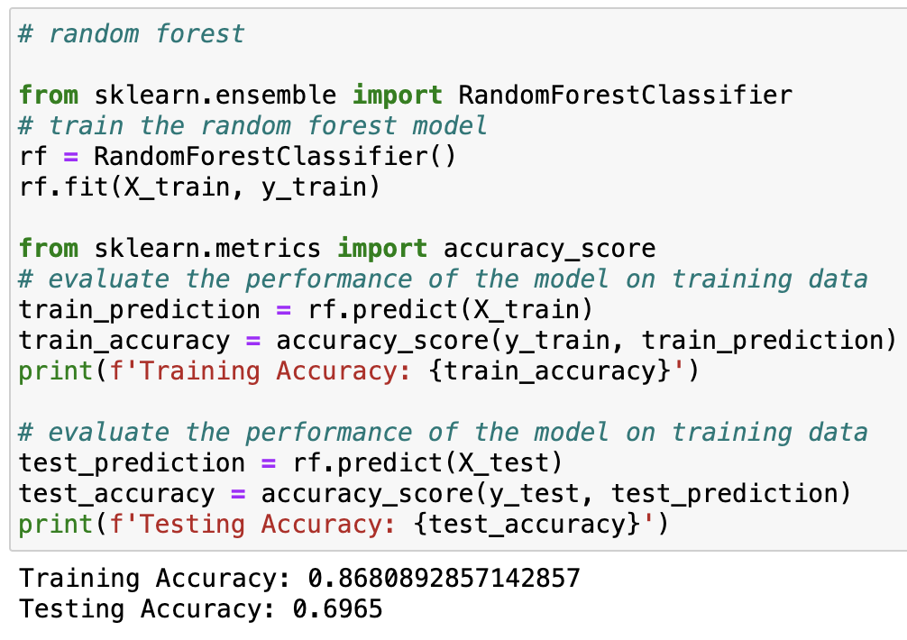
Random Forest
Random Forest is an algorithm widely used in machine learning for classification and regression.
It combines the output of multiple decision trees to reach a single result.

Slide 12
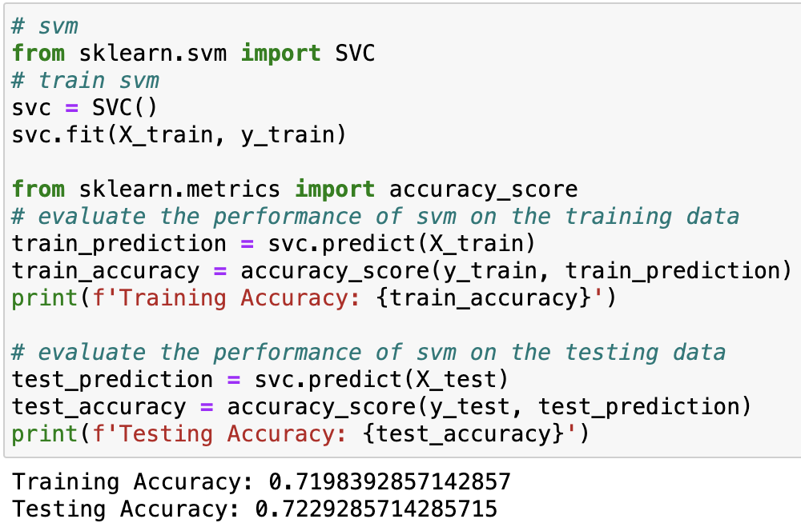
Support Vector machine(SVM)
SVM is a supervised machine learning approach utilized for regression as well as classification.
What it does is that it plots each item as a point in n-dimensional space.

Slide 13
Hyperparameter Tuning
Parameter and hyperparameter?
Fixed before training
Control the learning process
Tune the performance of a model
In our project, we use hyperparameter tuning for decision tree and random forest model.

Slide 14
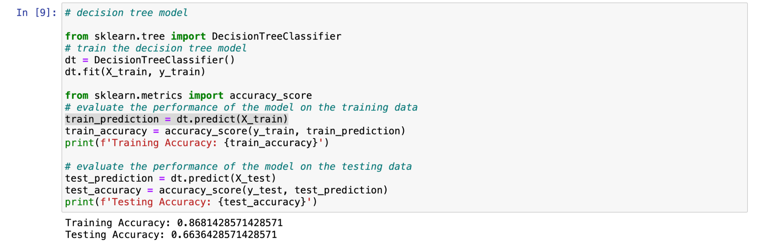
Before hyperparameter tuning:

Slide 15
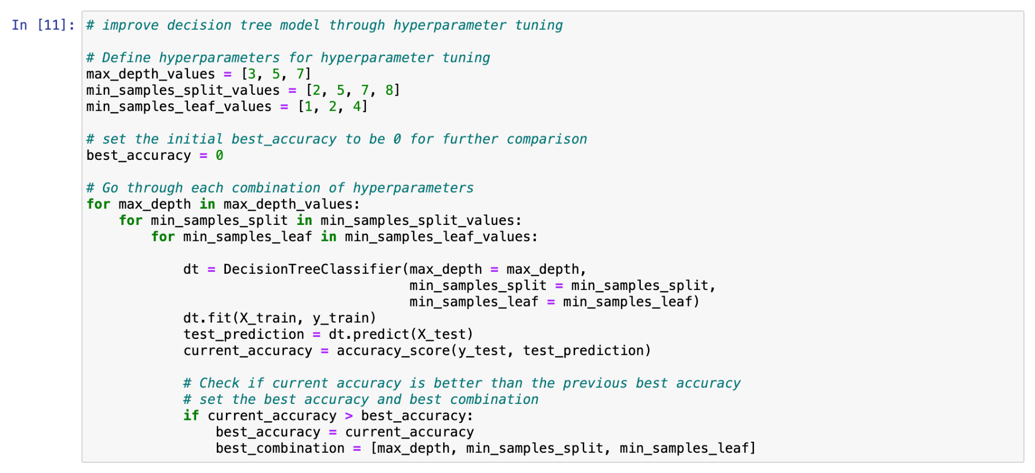
Grid search: best combination of hyperparameters

Slide 16
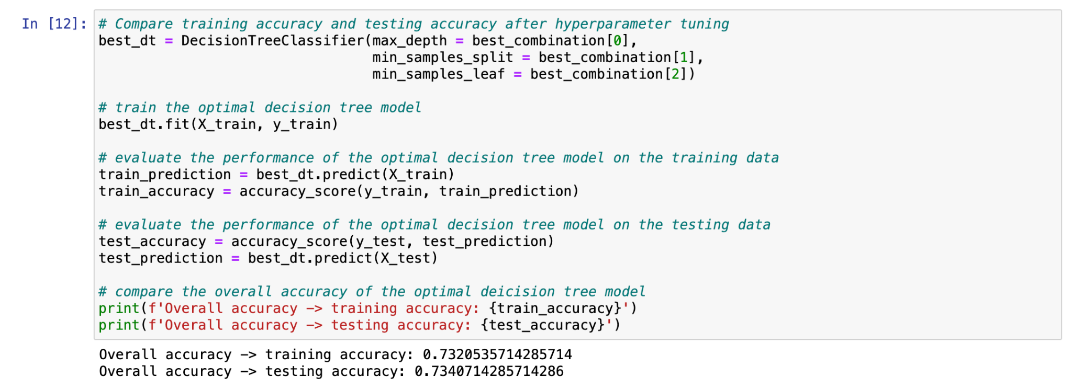
Training after hyperparameter tuning

Slide 17
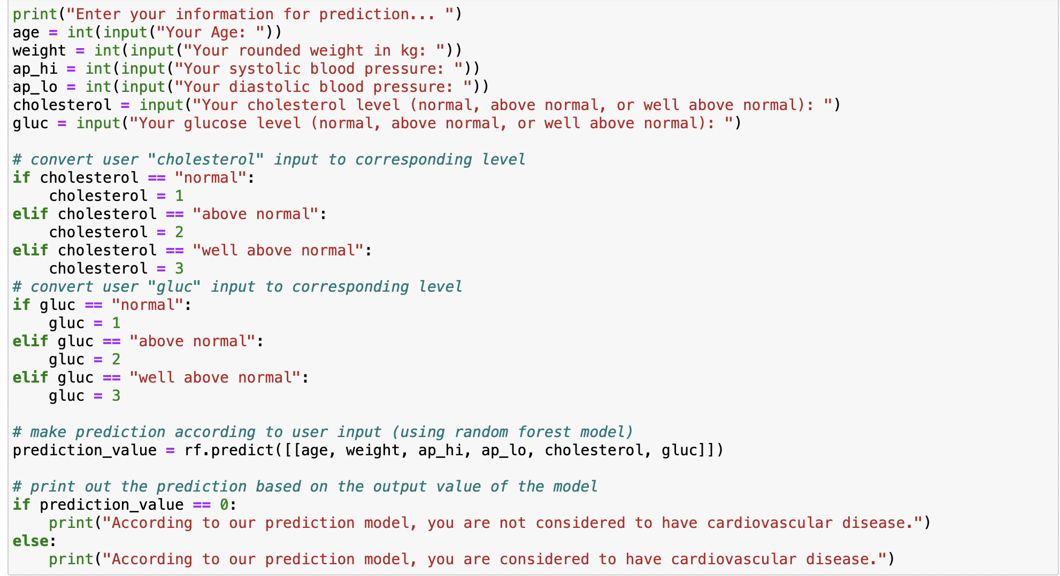
Example using prediction model

Slide 18
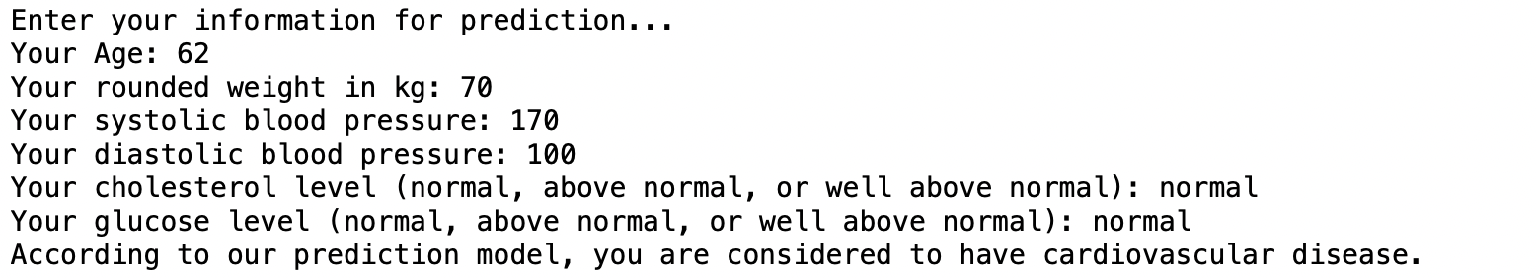
output:

Slide 19
Roles:
Yuyang Sun
Worked on Support Vector Machine
Worked on User Interface
Graphed factor layout plots
Xinyu Shen
Worked on Decision Tree
Graphed Comparison Graphs
Helped on Tuning models for higher accuracy
Xinye Li
Gathered datasets
Worked on Random Forest and Logistic Regression
Finished Tuning models for higher accuracy

